Slide 1

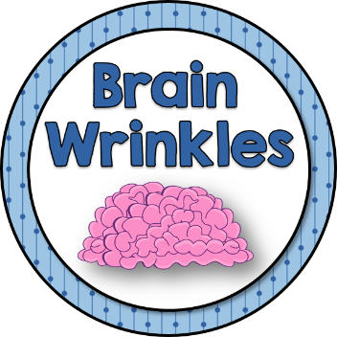
SS5H1
The
Civil War
Causes, Major Events,
and Consequences
© 2014 Brain Wrinkles

Slide 2
Standards
SS5H1 The student will explain the causes, major events, and consequences of the Civil War.
a. Identify Uncle Tom’s Cabin and John Brown’s raid on Harper’s Ferry, and explain how each of these events was related to the Civil War.
b. Discuss how the issues of states’ rights and slavery increased tensions between the North and South.
c. Identify major battles and campaigns: Fort Sumter, Gettysburg, the Atlanta Campaign, Sherman’s March to the Sea, and Appomattox Court House.
d. Describe the roles of Abraham Lincoln, Robert E. Lee, Ulysses S. Grant, Jefferson Davis, and Thomas “Stonewall” Jackson.
e. Describe the effects of war on the North and South.
© 2014 Brain Wrinkles

Slide 3
Differences
Large differences divided the northern and southern states long before the Civil War started in 1861.
The two important issues that increased tensions were slavery and states’ rights.
© 2014 Brain Wrinkles

Slide 4
States’ Rights
Many people in the South believed that states could choose which federal laws to obey.
  They believed that if a state didn’t like a law passed by the federal government, then they didn’t have to follow it.
Many also believed that any state could withdraw, or secede, from the Union if it chose to.
© 2014 Brain Wrinkles

Slide 5
States’ Rights
Most northerners believed that the states had to obey all the laws passed by the national government.
They also thought that no state could break its ties with the United States.
© 2014 Brain Wrinkles

Slide 6
Slavery
Slavery had existed in America since colonial times.
It was an important part of the South’s economy because slaveholders did not have to pay wages to workers.
  Southerners felt that it would be impossible to grow large cotton crops and sell them at a profit without using slaves.
© 2014 Brain Wrinkles

Slide 7
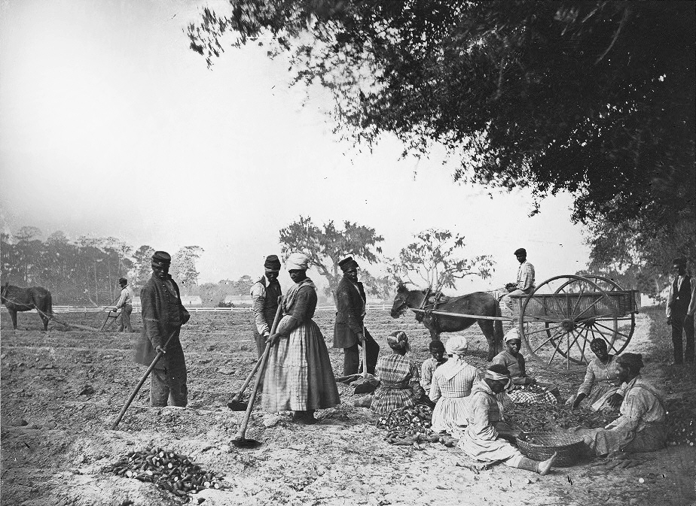
Planting Sweet Potatoes at a South Carolina Plantation - 1862
© 2014 Brain Wrinkles

Slide 8
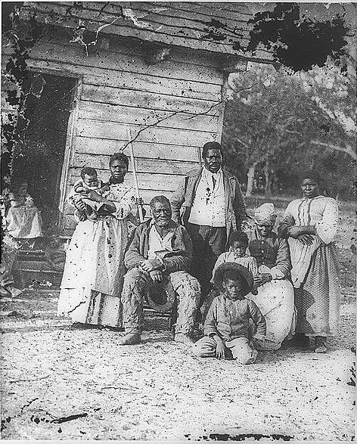
Four Generations of a Slave Family (Photographed during the Civil war) – Beaufort, South Carolina 1862
© 2014 Brain Wrinkles

Slide 9
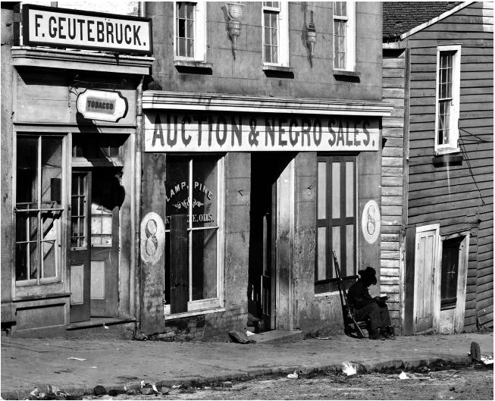
Slave Trader’s Business in Atlanta, 1860s
© 2014 Brain Wrinkles

Slide 10
Slavery
Many northerners felt it was wrong for one person to own another.
  They were abolitionists because they wanted to put an end to, or abolish, slavery.
Southerners disagreed, saying that the abolition of slavery would destroy the South’s economy.
© 2014 Brain Wrinkles

Slide 11
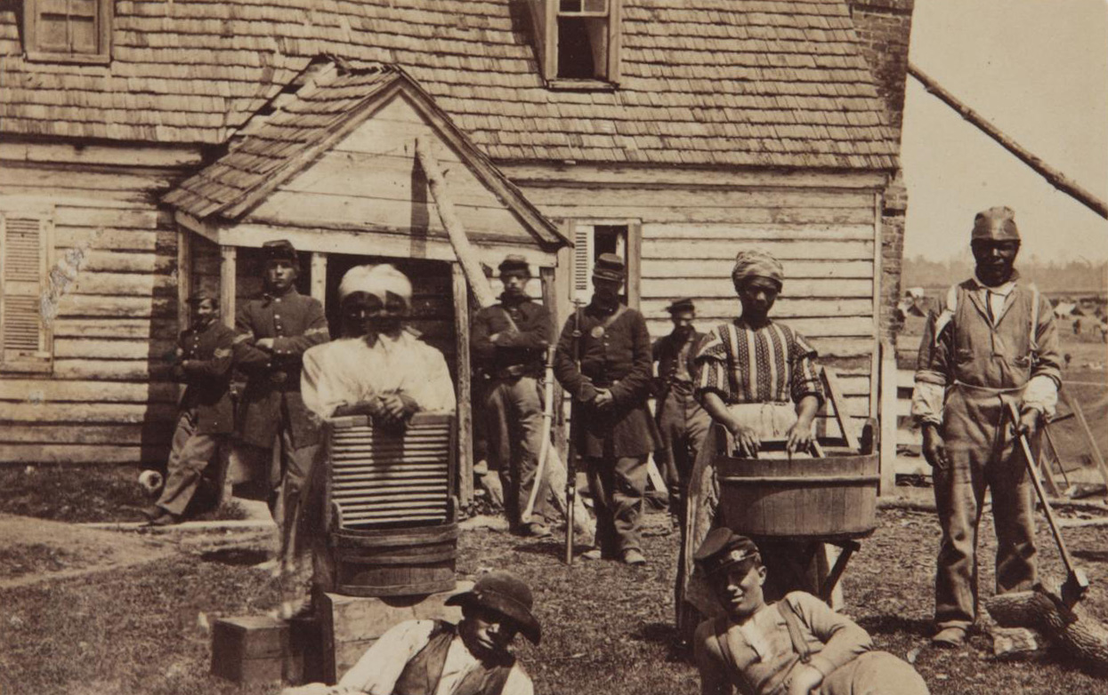
Escaped Slaves - 1862
© 2014 Brain Wrinkles

Slide 12
Uncle Tom’s Cabin
Uncle Tom’s Cabin is a novel written by abolitionist Harriet Beecher Stowe in 1852.
The book is about a cruel slave owner’s shocking treatment of slaves.
It showed the evils of slavery and turned many people against it.
President Lincoln called the author “the little lady who made this big war.”
© 2014 Brain Wrinkles

Slide 13
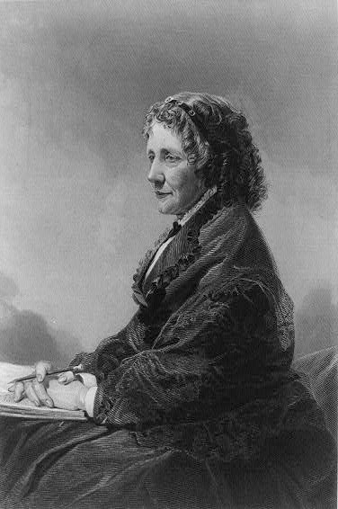
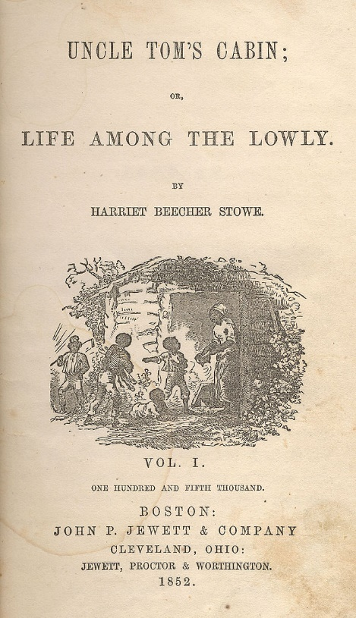
Uncle Tom’s Cabin
by Harriet Beecher Stowe
1852
“Helped lay the groundwork for the Civil War.”
© 2014 Brain Wrinkles

Slide 14
Raid on Harper’s Ferry
In 1859, abolitionist John Brown led a group of rebels to a gun facility in Harper’s Ferry, West Virginia to protest slavery.
The group attempted to help slaves by giving them guns to rebel against their masters, but they were soon surrounded by local troops.
© 2014 Brain Wrinkles

Slide 15
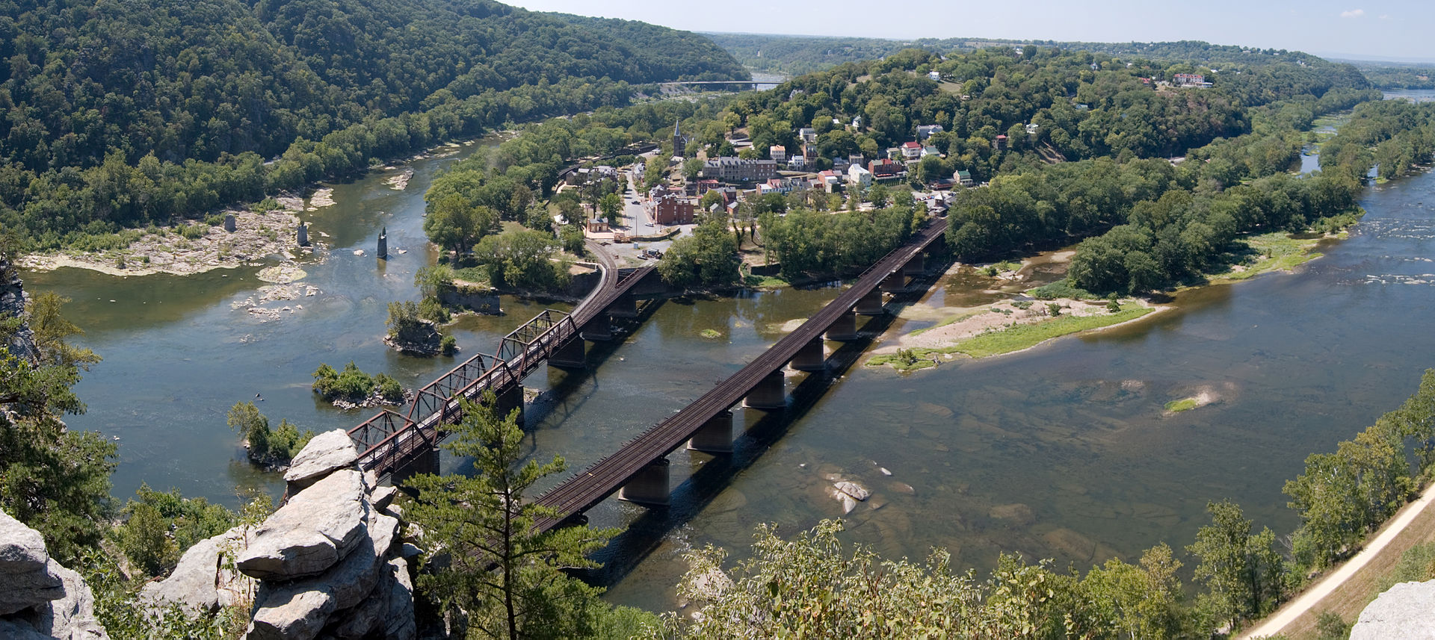
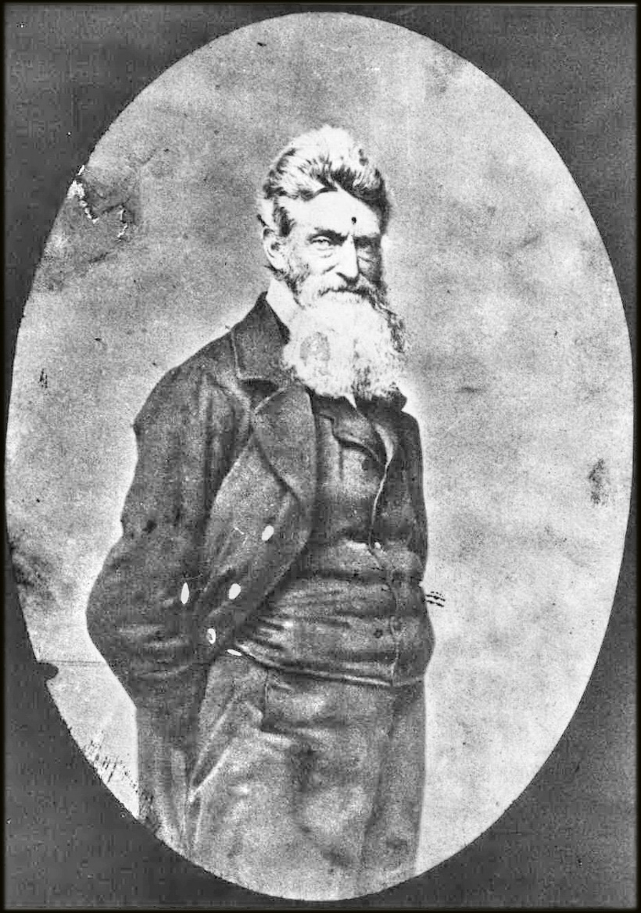
Harper’s Ferry, West Virginia
John Brown
© 2014 Brain Wrinkles

Slide 16
Raid on Harper’s Ferry
Two of his sons were killed, but John Brown refused to surrender and was eventually captured.
  He was put on trial, found guilty of treason, and was hanged for his involvement in the raid at Harper’s Ferry.
This event proved that people were willing to use violence to end slavery.
© 2014 Brain Wrinkles

Slide 17
Abraham Lincoln
Abraham Lincoln was elected 16th president of the United States in 1860.
Many Southerners believed that he would try to put an end to slavery, so some of the southern states seceded from the Union after his election.
© 2014 Brain Wrinkles

Slide 18
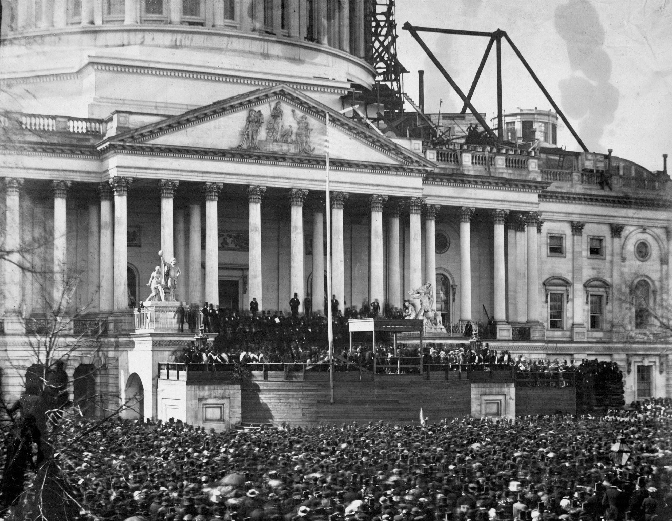
President Lincoln’s Inauguration at the U.S. Capitol, 1861
© 2014 Brain Wrinkles

Slide 19
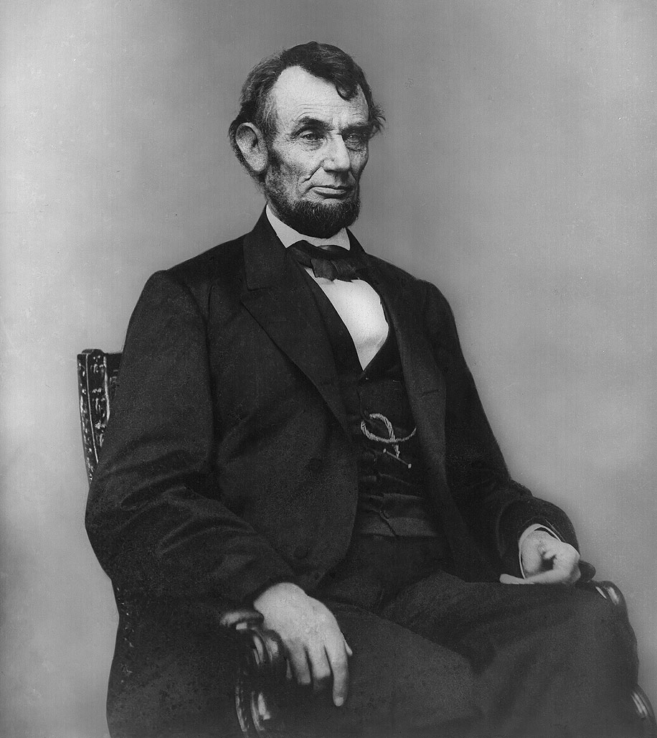
Abraham Lincoln
1864
© 2014 Brain Wrinkles

Slide 20
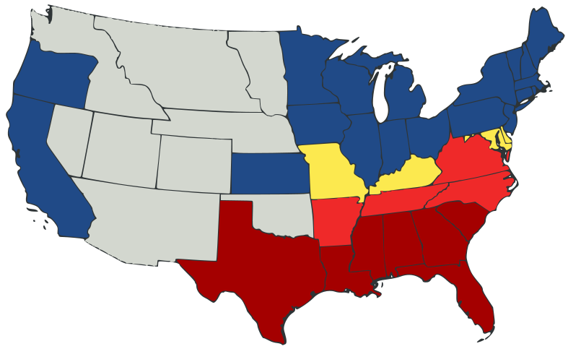
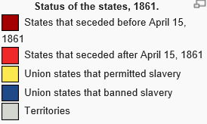
Status of the States, 1861
© 2014 Brain Wrinkles

Slide 21
Abraham Lincoln
In 1863, he issued the Emancipation Proclamation, which declared that all slaves in areas still fighting against the North were free.
On April 14, 1965, just a few days after the South surrendered, Lincoln was assassinated by John Wilkes Booth.
© 2014 Brain Wrinkles

Slide 22
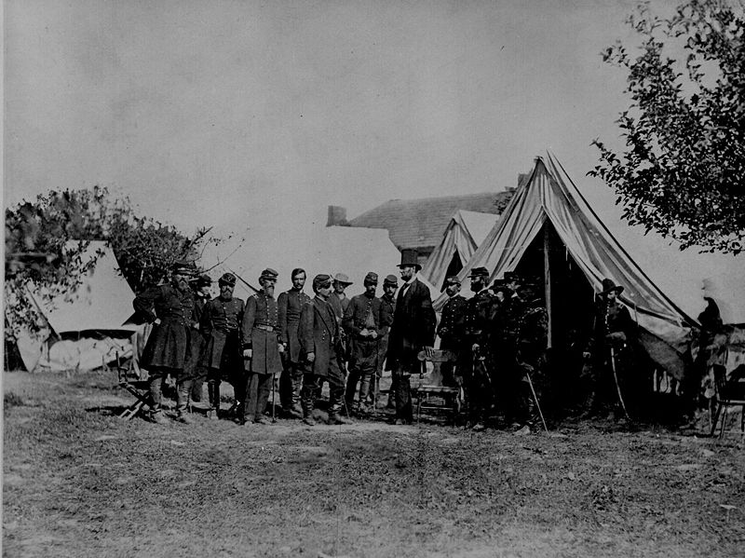
President Lincoln visiting the battlefield at Antietam, Maryland – October 3, 1862
© 2014 Brain Wrinkles

Slide 23
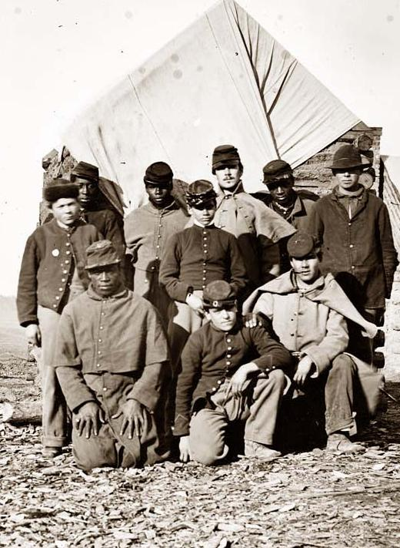
Many fugitive slaves fled to the Union Army. They were officially freed with the Emancipation Proclamation in 1863.
© 2014 Brain Wrinkles

Slide 24
Jefferson Davis
The Confederate States of America consisted of South Carolina, Georgia, Mississippi, North Carolina, Florida, Alabama, Tennessee, Arkansas, and Louisiana.
When the confederate states seceded from the Union, they elected Jefferson Davis as their president.
© 2014 Brain Wrinkles

Slide 25
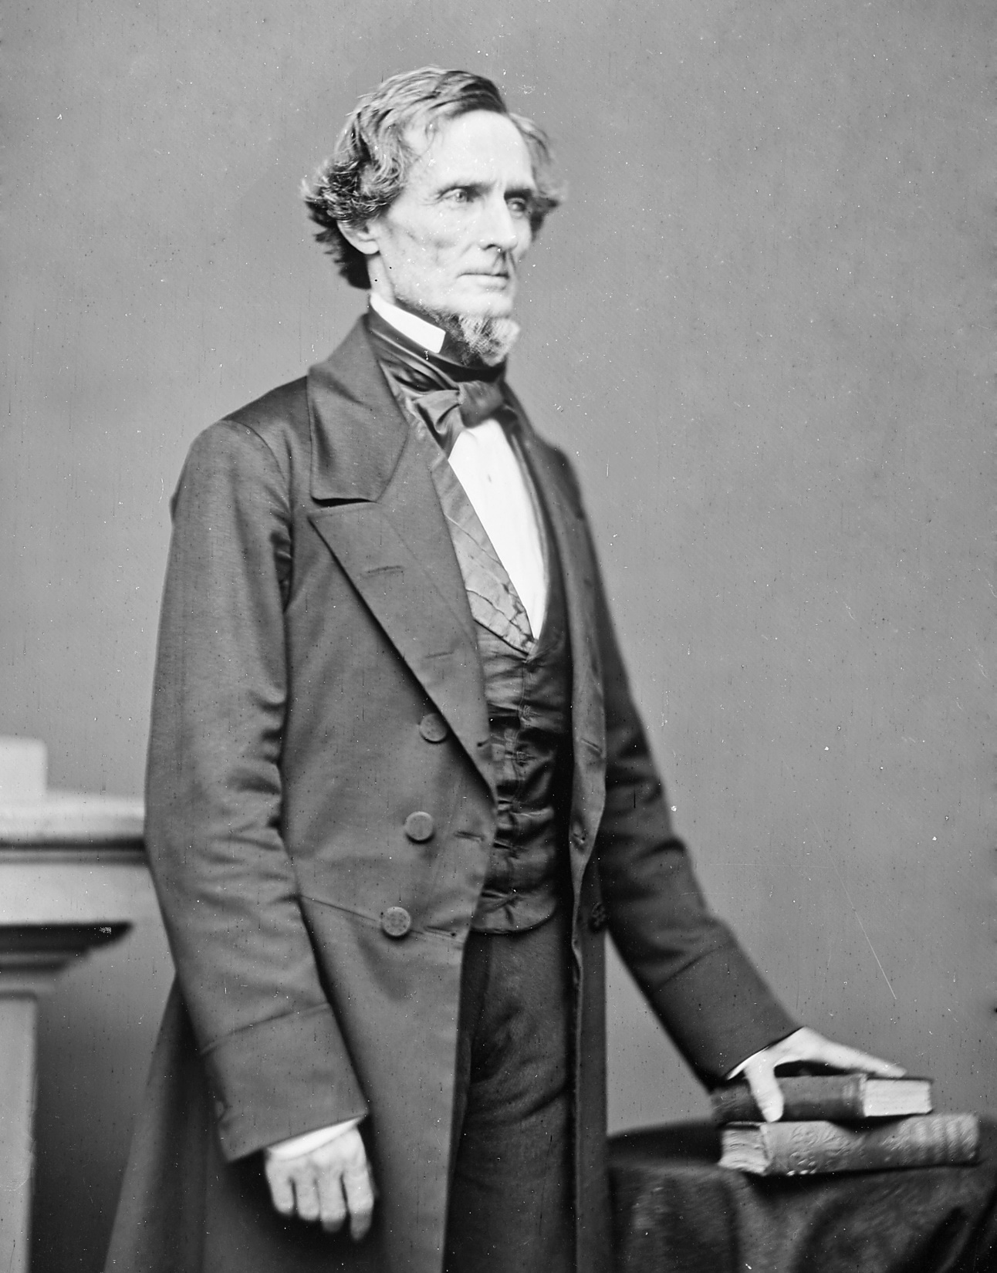
Jefferson Davis
1861
© 2014 Brain Wrinkles

Slide 26
Jefferson Davis
Prior to becoming president of the Confederate States, Davis was a plantation owner in Mississippi.
During the war, he clashed with many Southern leaders and was blamed by many for the South’s loss.
After the war, Davis was supposed to be tried for treason.
  The trial never took place, and he was freed after 2 years.
© 2014 Brain Wrinkles

Slide 27
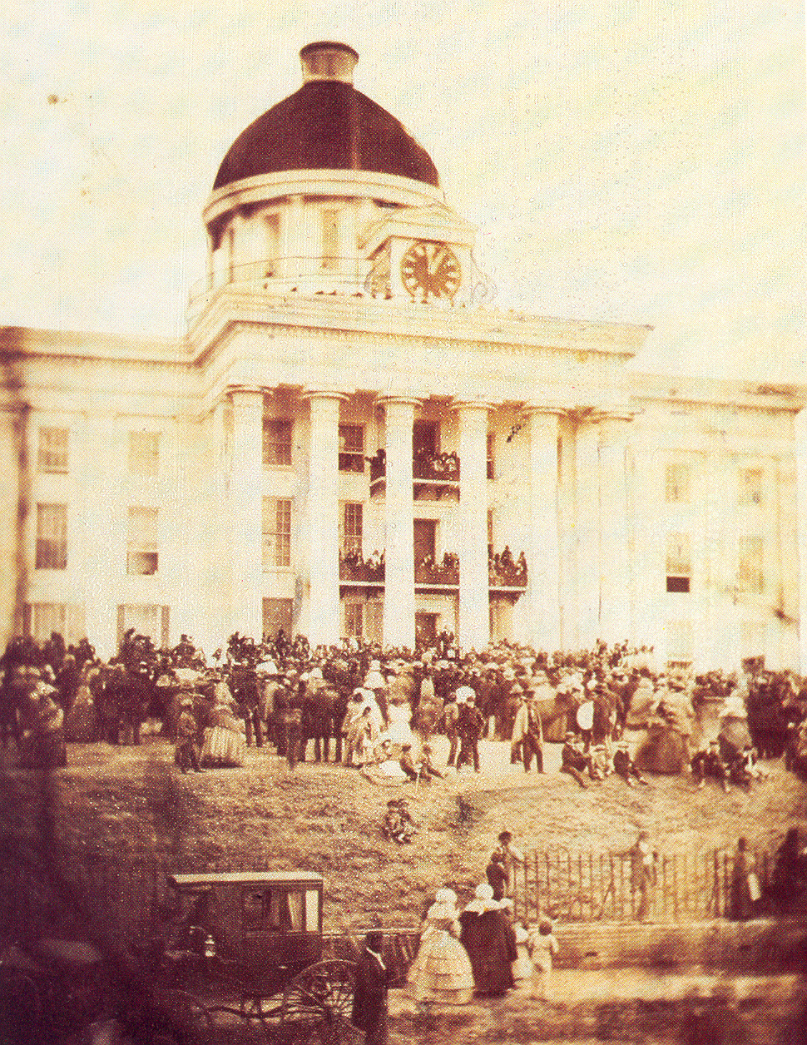
Jefferson Davis’ Inauguration as President of the Confederate States of America – Montgomery, Alabama 1861
© 2014 Brain Wrinkles

Slide 28
Robert E. Lee
Robert E. Lee was one of the greatest military leaders of the Civil War.
  He was a graduate of the US Military Academy at West Point and fought in the US Army during the Mexican War.
  Lee was from Virginia.
He was originally offered the command of the Union Army.
  Because Virginia seceded, he felt it was his duty to defend his home state.
© 2014 Brain Wrinkles

Slide 29
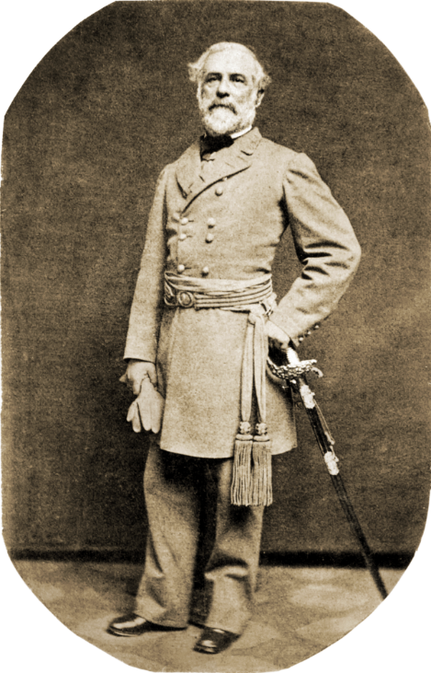
Robert E. Lee
1863
© 2014 Brain Wrinkles

Slide 30
Robert E. Lee
Lee left the US Army to lead the Army of Northern Virginia for the Confederacy.
  Lee did not support slavery, but wanted to stay loyal to his home state of Virginia.
After the war, Lee became president of Virginia’s Washington College, which was later renamed Washington and Lee University.
© 2014 Brain Wrinkles

Slide 31
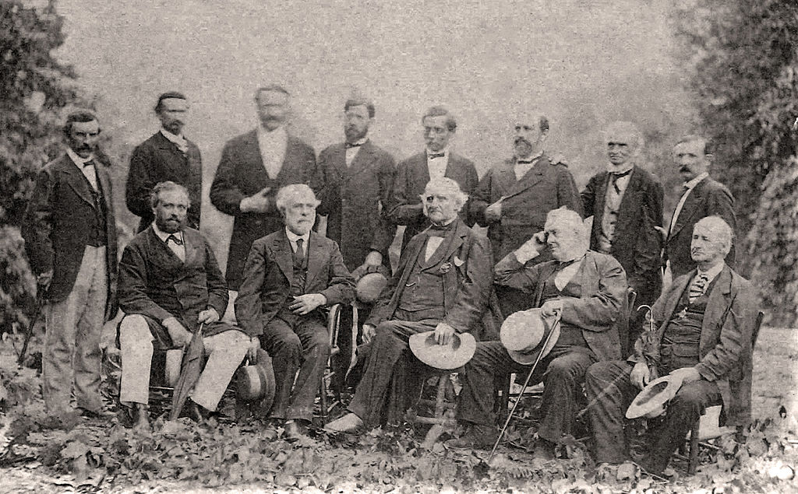
General Lee with his Confederate officers
© 2014 Brain Wrinkles

Slide 32
Ulysses S. Grant
Ulysses S. Grant was also one of the greatest military leaders of the Civil War.
  He was a graduate of the US Military Academy at West Point and fought in the US Army during the Mexican War.
Grant left the army after that war to become a businessman.
© 2014 Brain Wrinkles

Slide 33
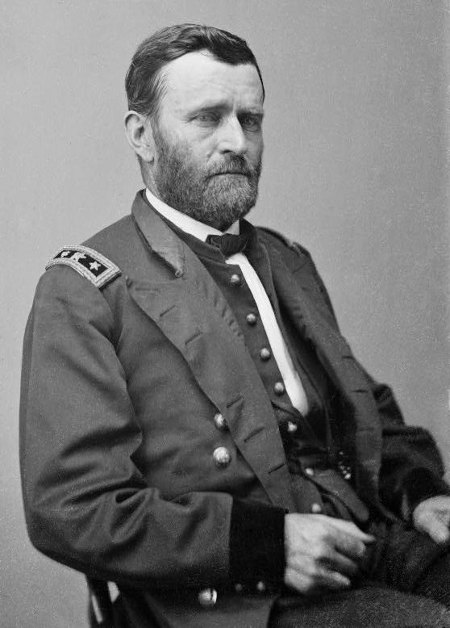
Ulysses S. Grant
1862
© 2014 Brain Wrinkles

Slide 34
Ulysses S. Grant
Grant rejoined the army in 1861 and eventually became the North’s leading general.
He was a master of military strategy.
Grant’s troops defeated Lee’s army in 1865, ending the Civil War.
Ulysses S. Grant was elected president of the United States in 1868 and served two terms.
© 2014 Brain Wrinkles

Slide 35
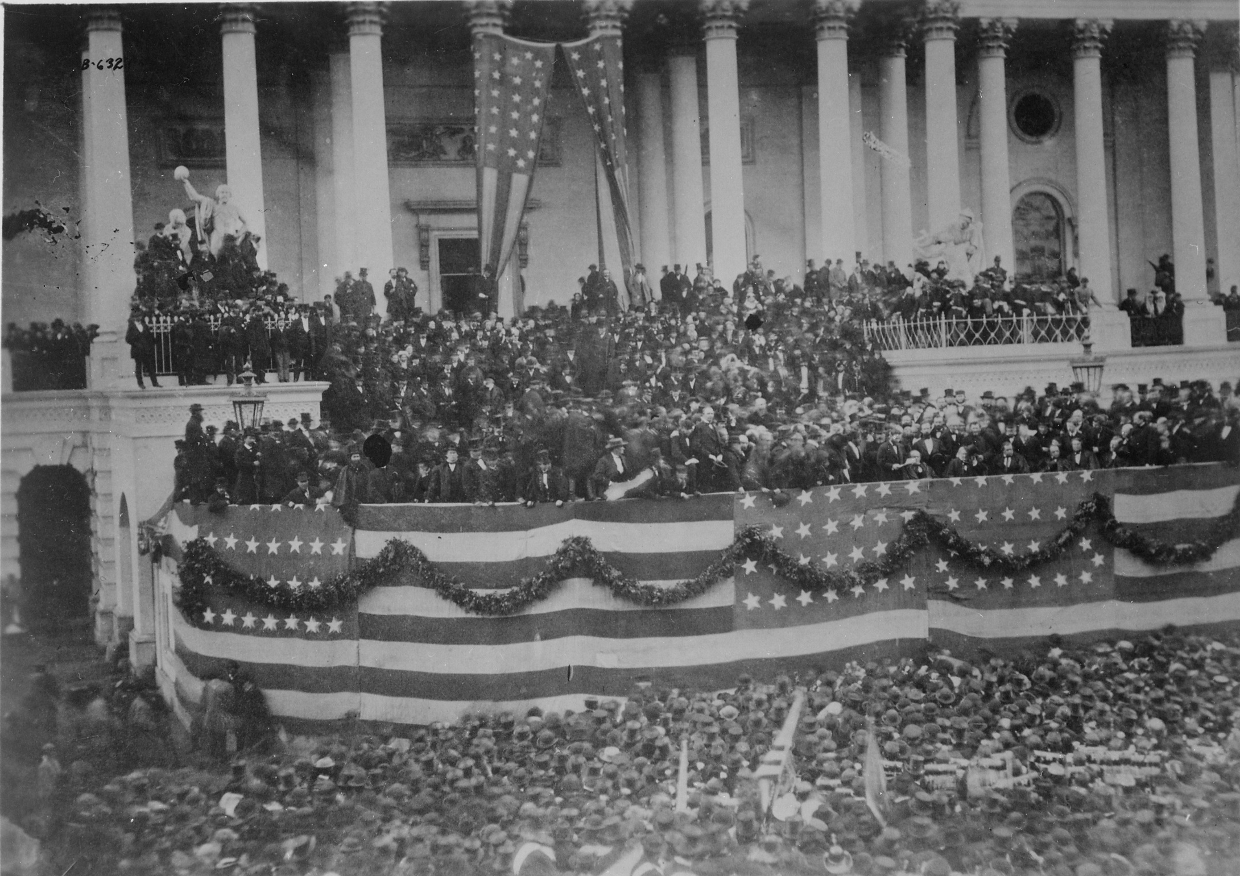
Grant’s First Inauguration
1868
© 2014 Brain Wrinkles

Slide 36
Stonewall Jackson
Thomas “Stonewall” Jackson was a skilled Confederate general from Virginia.
He earned the nickname “Stonewall” during the first battle of Bull Run.
  General Bernard Bee saw him bravely facing the enemy and said, “There stands Jackson like a stone wall.”
He became a hero after his victories in the Shenandoah Valley.
© 2014 Brain Wrinkles

Slide 37
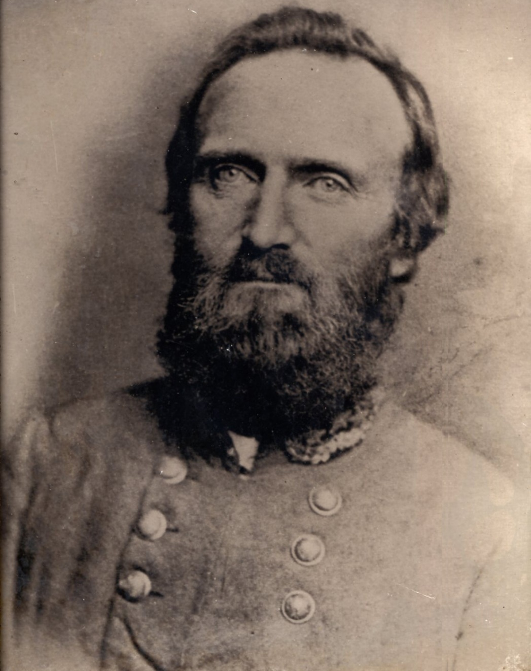
Thomas “Stonewall” Jackson
© 2014 Brain Wrinkles

Slide 38
Stonewall Jackson
In 1863, Jackson was mortally wounded by his own troops.
  He had his left arm amputated, but died of pneumonia eight days later.
Before his death, Robert E. Lee said, “He has lost his left arm, but I have lost my right arm.”
© 2014 Brain Wrinkles

Slide 39
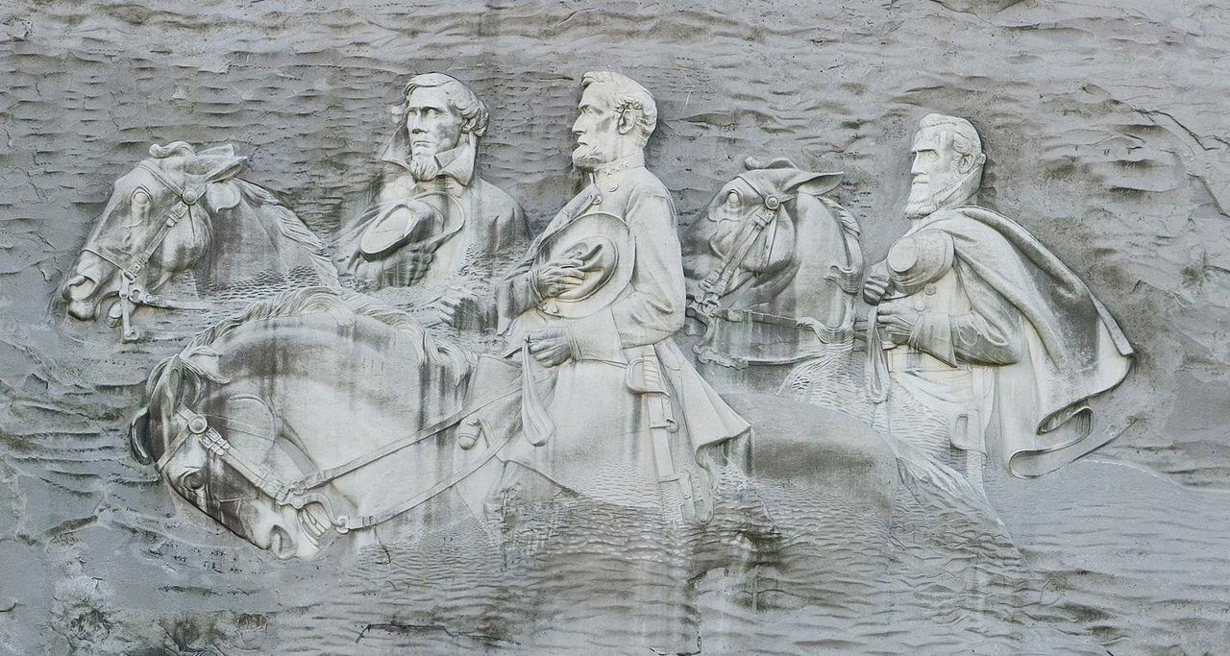
Jefferson Davis, Robert E. Lee, and Stonewall Jackson
Stone Mountain, Georgia
© 2014 Brain Wrinkles

Slide 40
Fort Sumter
The Civil War began on April 12, 1861, when Confederate forces fired on Fort Sumter.
  Fort Sumter was a Union fort in the harbor of Charleston, South Carolina.
The Union forces inside Fort Sumter were already low on ammunition and food, so they surrendered the next day.
Nobody was killed during the actual battle; however, one person was killed in a 50-gun salute to the flag.
© 2014 Brain Wrinkles

Slide 41
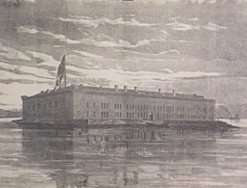
Fort Sumter, South Carolina – Before the Civil War
© 2014 Brain Wrinkles

Slide 42
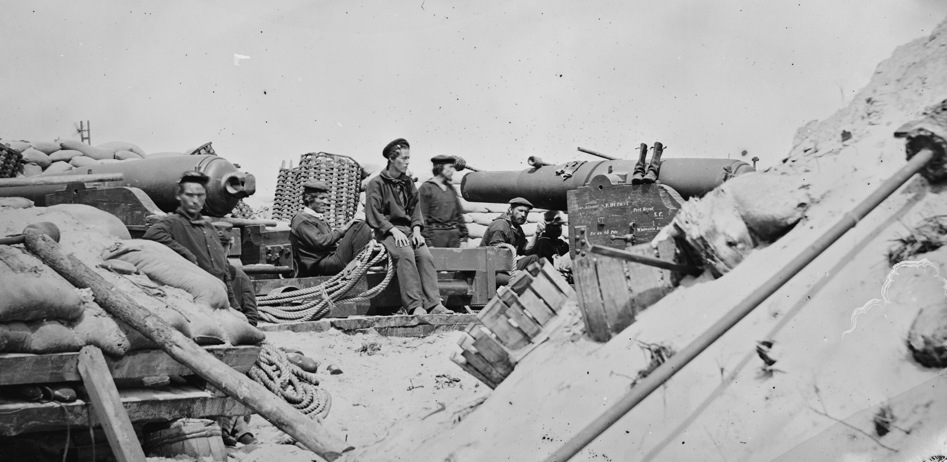
Whitworth Rifles in defense of Charleston.
© 2014 Brain Wrinkles

Slide 43
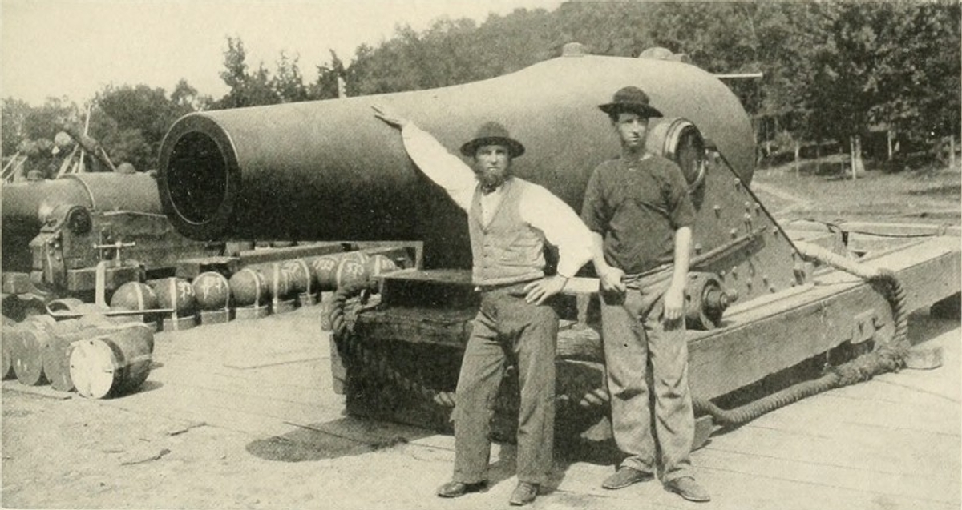
Union siege guns mounted in defense of Washington, 1864.
© 2014 Brain Wrinkles

Slide 44
Gettysburg
The Battle at Gettysburg, Pennsylvania on July 1-3, 1863, was the turning point of the war.
Confederate forces under Lee were trying to invade the North, but they were stopped.
This Union victory left the South with no chance of winning the war.
© 2014 Brain Wrinkles

Slide 45
Gettysburg
Afterwards, President Lincoln made a speech at a ceremony dedicating the site as a cemetery.
The Gettysburg Address lasted only three minutes, but it is regarded as one of the most inspiring speeches in American history.
In the speech, Lincoln said that the Civil War was to preserve a government “of the people, by the people, and for the people”.
© 2014 Brain Wrinkles

Slide 46
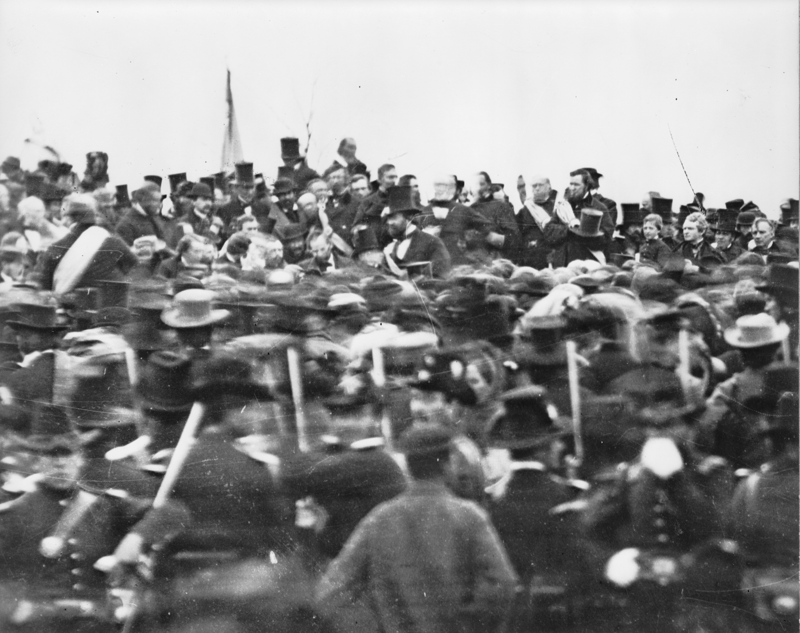
The only confirmed photo of Lincoln at Gettysburg
© 2014 Brain Wrinkles

Slide 47
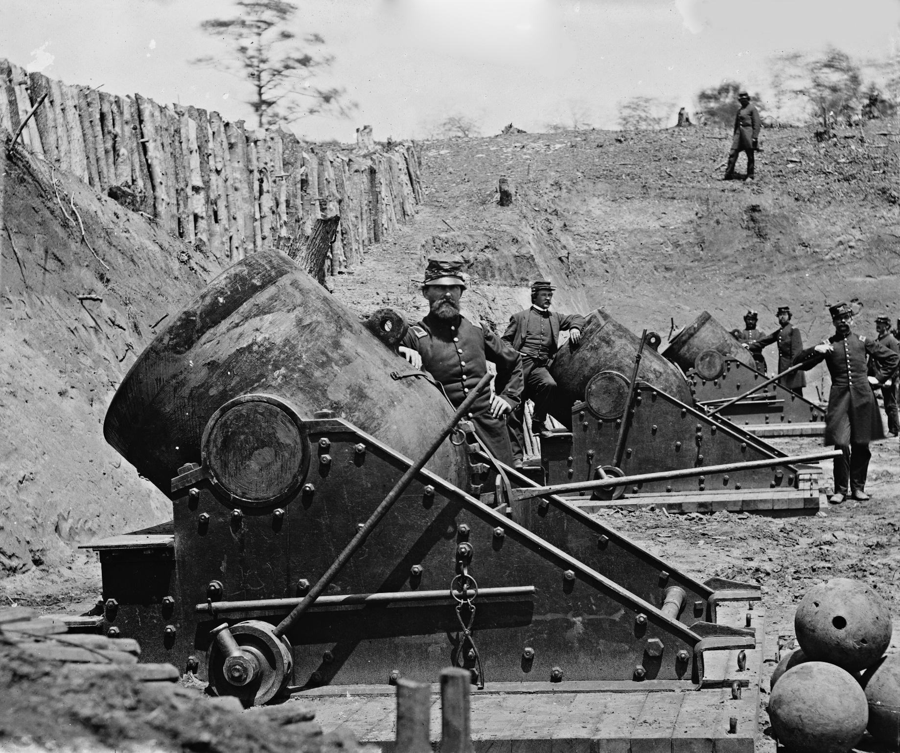
Mortars in 1862
© 2014 Brain Wrinkles

Slide 48
Atlanta Campaign
In 1864, General William Tecumseh Sherman moved his Union Army south from Tennessee to Atlanta.
They fought Confederate soldiers along the way, leaving a path of destruction and chaos.
On September 2, 1864, Sherman’s troops captured Atlanta and set the city on fire.
© 2014 Brain Wrinkles

Slide 49
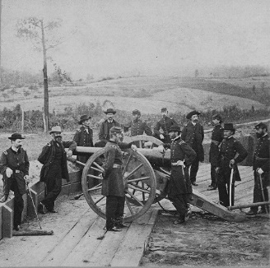
General Sherman & His Officers in Atlanta
© 2014 Brain Wrinkles

Slide 50
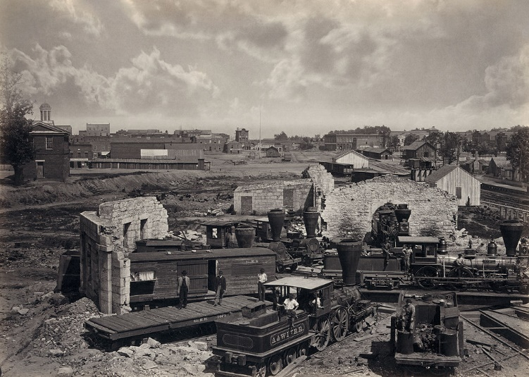
Destroyed Train Roundhouse in Atlanta
© 2014 Brain Wrinkles

Slide 51
March to the Sea
In November 1864, Sherman began his march through Georgia from Atlanta to Savannah.
  His troops destroyed many towns and plantations along the way.
Sherman’s “March to the Sea” cut Confederate supply lines and crushed the spirit of the Confederate army.
  They captured Savannah on December 21, 1864, and Sherman gave the city of Savannah to Abraham Lincoln as a Christmas gift.
© 2014 Brain Wrinkles

Slide 52
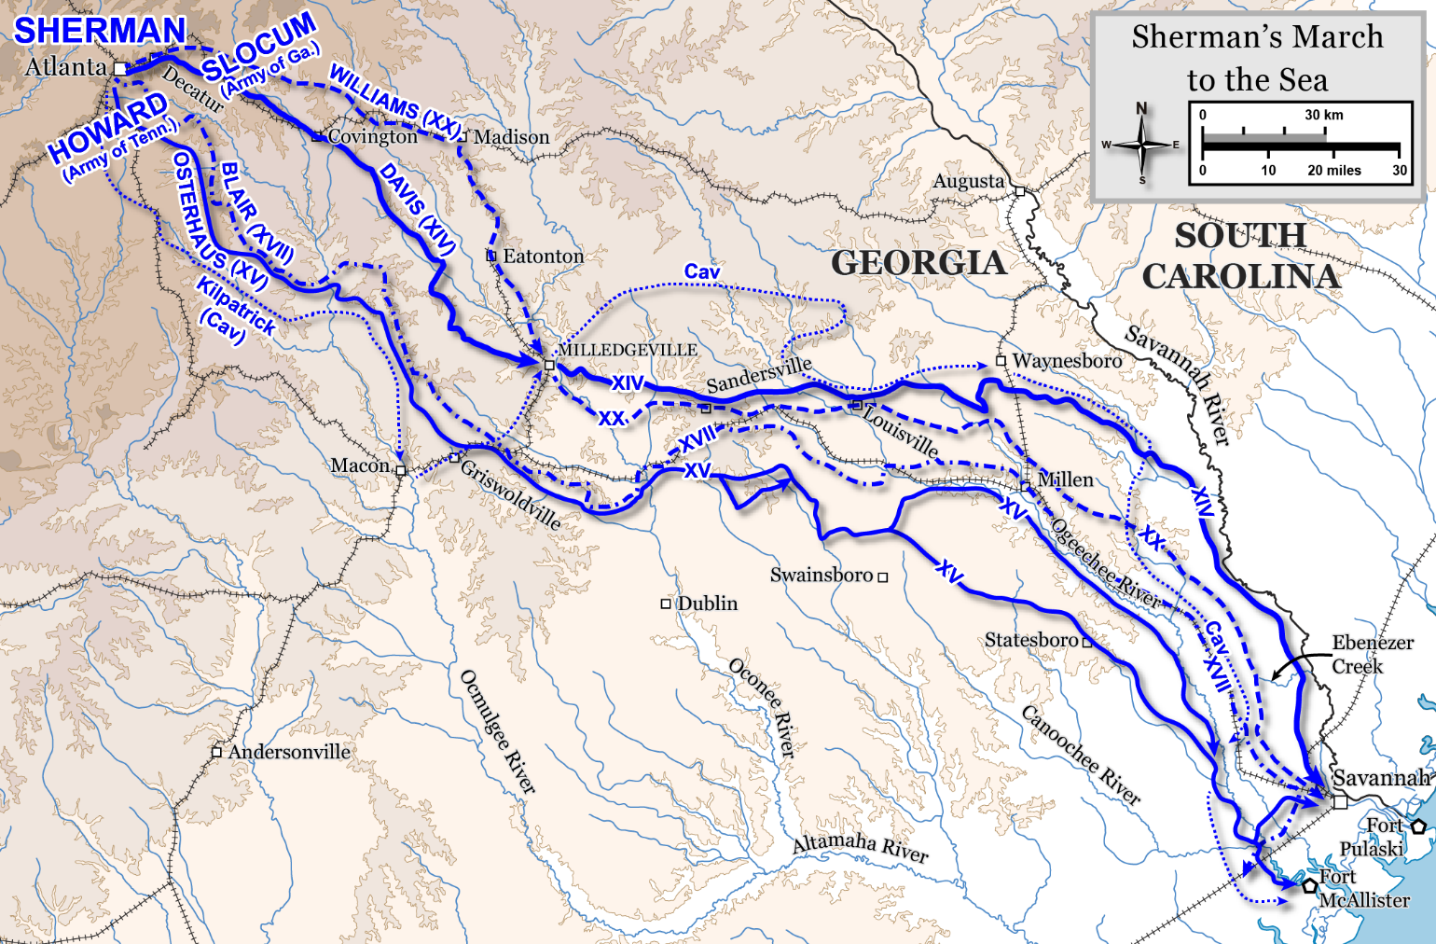
© 2014 Brain Wrinkles

Slide 53
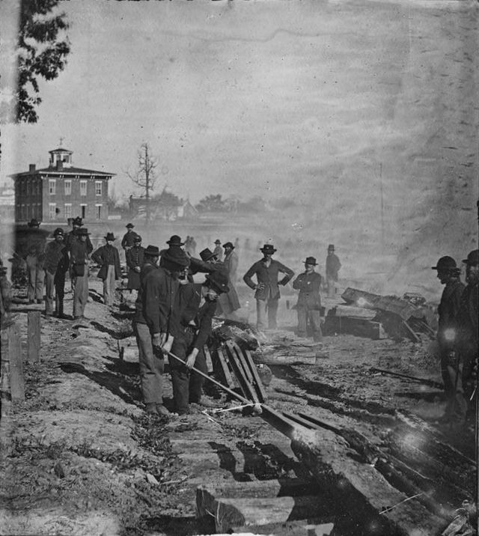
Sherman’s Men Destroying a
Railroad in Georgia
© 2014 Brain Wrinkles

Slide 54
Appomattox
In early April, Union troops finally took Richmond, Virginia, the capital of the Confederacy.
On April 9, 1865, General Lee surrendered to General Grant at Wilmer McLean’s house in the town of Appomattox Court House, Virginia.
The Civil War was finally over.
    Instead of celebrating, soldiers on both sides went home quietly.
Just a few days later, on April 14, 1865, Abraham Lincoln was assassinated.
© 2014 Brain Wrinkles

Slide 55
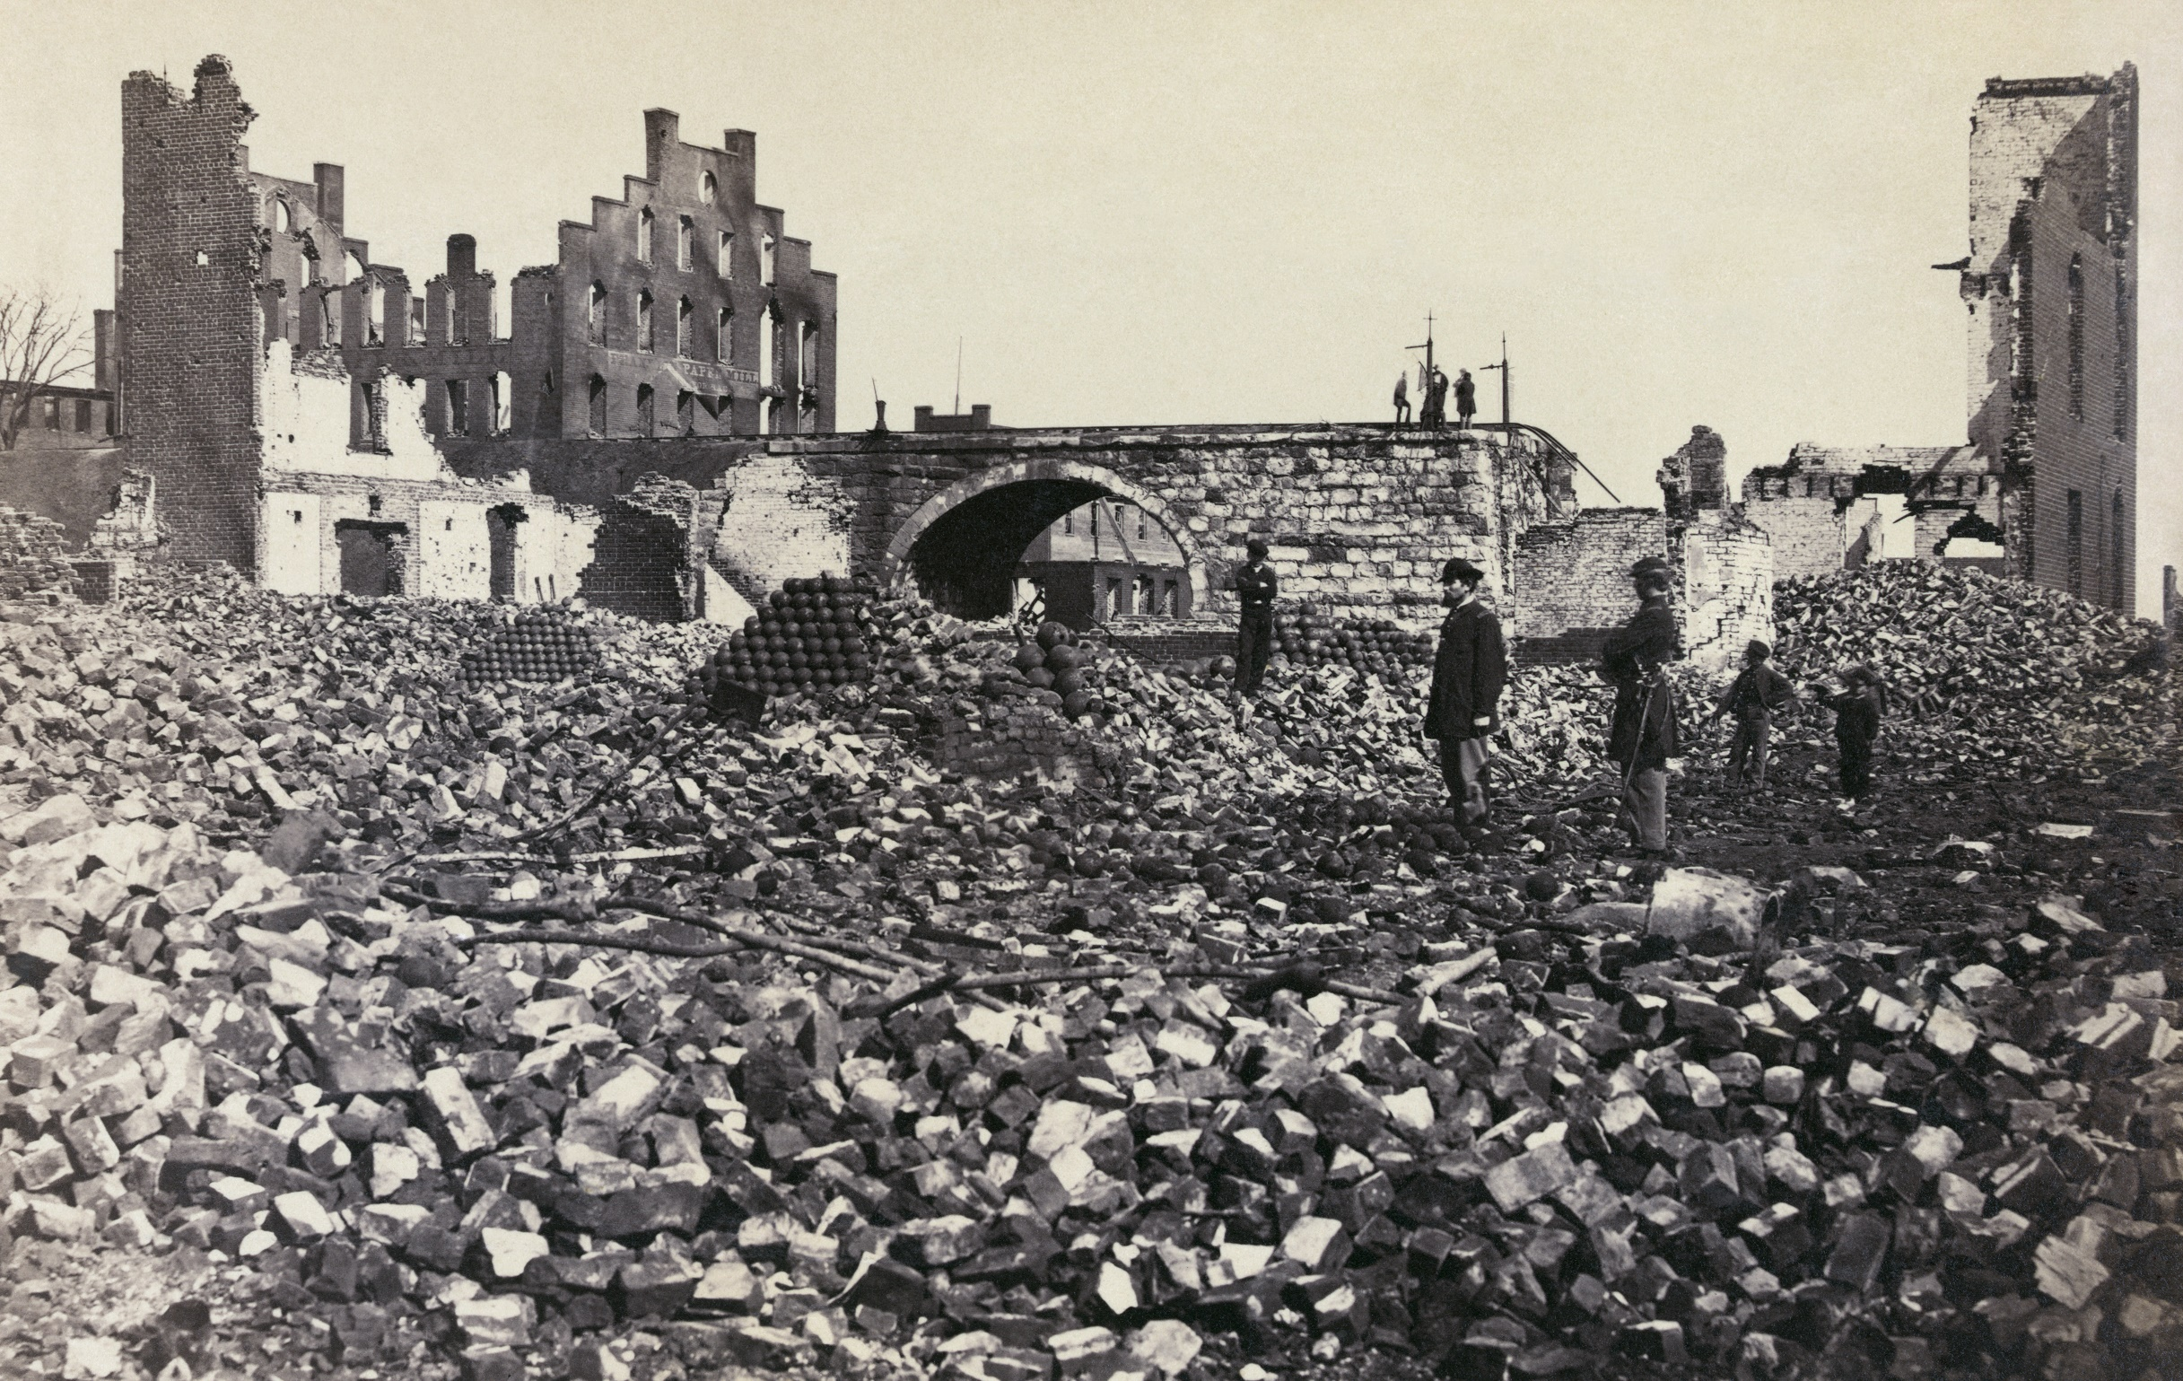
Richmond, Virginia in Ruins – April 1865
© 2014 Brain Wrinkles

Slide 56
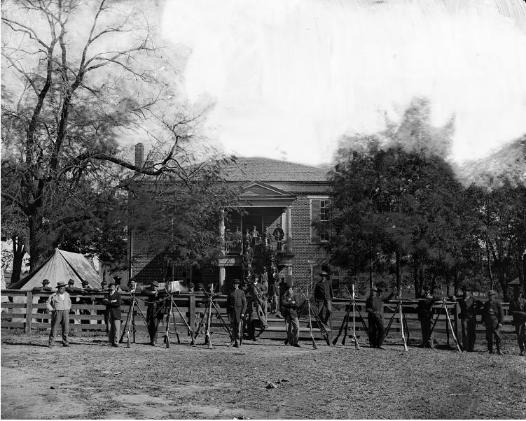
Union Army Soldiers– April 9, 1856
Appomattox Court House, VA
© 2014 Brain Wrinkles

Slide 57
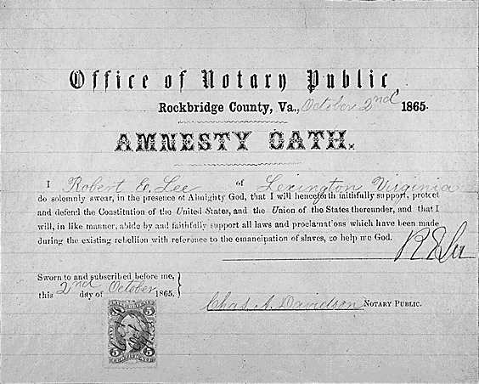
Robert E. Lee’s Amnesty Oath to the US Constitution
October 2nd, 1865
© 2014 Brain Wrinkles

Slide 58
War’s Effects
The Civil War had major effects on the United States.
  These effects were mostly positive in the northern and western parts of the country.
  In the South, they were disastrous.
The war had been fought mostly on Southern soil.
  Many homes, cities, railroads, farms, etc., had been destroyed and had to be rebuilt after the war.
But the southern states had little money to do so.
  They were financially bankrupt and could not pay their war debts.
© 2014 Brain Wrinkles

Slide 59
War’s Effects
While much of the South had been devastated by the war, the Northern economy prospered.
New factories had been built in many cities and more railroads had been laid.
Northerners had made millions of dollars producing guns, ammunition, clothing, and other war materials.
Northern cities continued to grow.
© 2014 Brain Wrinkles

